Slide 1
Linux Kernel
Lecture 3:
Process & Thread

Slide 2
Recall: OS Resources – at the center of it all!
What do modern OSs do?
Why all of these pieces running together?
Is this complexity necessary?
Control of Resources
Access/No Access/ Partial Access
Check every access to see if it is allowed
Resource Multiplexing
When multiple valid requests occur at same time – how to multiplex access?
What fraction of resource can requester get?
Performance Isolation
Can requests from one entity prevent requests from another?
What or Who is a requester???
Process? User? Public Key?
Think of this as a “Principle”
Independent
Requesters
Access Control and Multiplexing

Slide 3
Layered Structure
Operating system is divided many layers (levels)
Each built on top of lower layers
Bottom layer (layer 0) is hardware
Highest layer (layer N) is the user interface
Each layer uses functions (operations) and services of only lower-level layers
Advantage: modularity ⇒ Easier debugging/Maintenance
Not always possible: Does process scheduler lie above or below virtual memory layer?
Need to reschedule processor while waiting for paging
May need to page in information about tasks
Important: Machine-dependent vs independent layers
Easier migration between platforms
Easier evolution of hardware platform
Good idea for you as well!
Can utilize hardware enforcement
x86 processor: 4 “rings”
Call gates

Slide 4
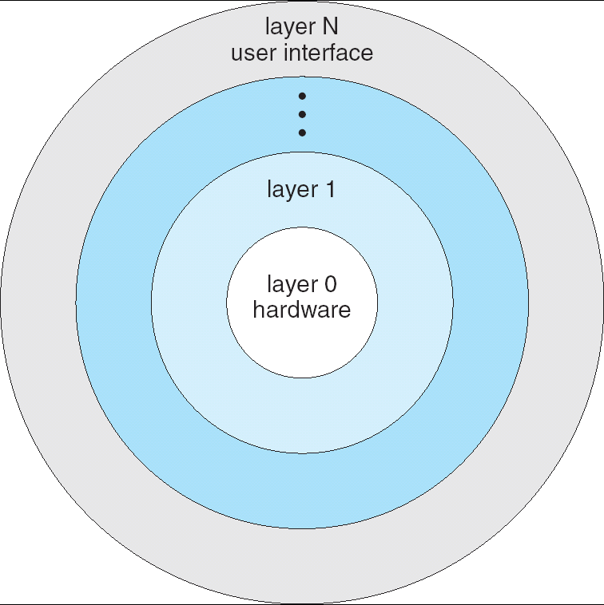
Layered Operating System

Slide 5
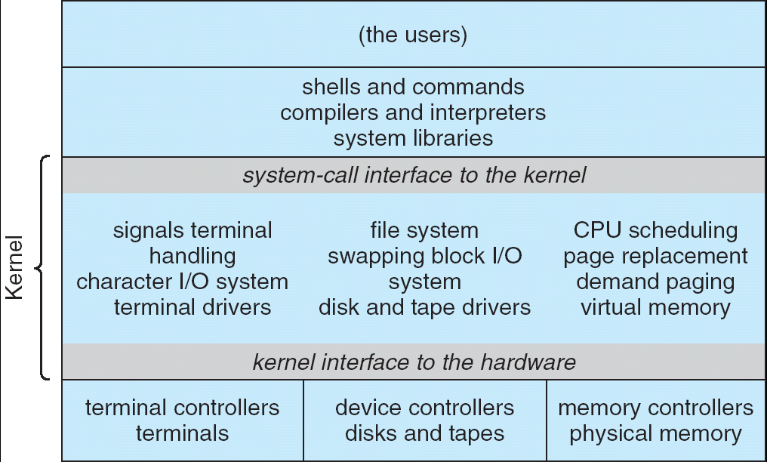
Monolithic Structure: UNIX System Structure
Applications
User Mode
Standard Libs
Kernel Mode
Hardware
Two-Layered Structure: User vs Kernel
All code representing protection and management of resources placed in same address space
Compromise of one component can compromise whole OS
Clear division of labor?
The producer of the OS and the User of the OS

Slide 6
Layout of Linux Sources
Layout of basic linux sources:
jackie@ubuntu(16)% ls
arch/ drivers/ Kbuild modules.builtin samples/ usr/
block/ firmware/ kernel/ modules.order scripts/ virt/
COPYING fs/ lib/ Module.symvers security/ vmlinux*
CREDITS include/ MAINTAINERS net/ sound/ vmlinux.o
crypto/ init/ Makefile README System.map
Documentation/ ipc/ mm/ REPORTING-BUGS tools/
jackie@ubuntu(17)%

Slide 7
Layout of Linux Sources
Specific Directories:
arch: Architecture-specific source
block: Block I/O layer
crypto: Crypto API
Documentation: Kernel source Documentation
drivers: Device drivers
firmware: Device firmware needed to use certain drivers
fs: The VFS and individual filesystems
include: Kernel headers
init: Kernel boot and initialization
ipc: Interprocess Communication code
kernel: Core subsystems, such as the scheduler
lib: Helper routines
mm: Memory management subsystem and the vm
net: Networking subsystem
samples: Sample, demonstrative code
scripts: Scripts used to build the kernel
security: Linux Security Module
sound: Sound subsystem
usr: Early user-space code (called initramfs)
tools: Tools helpful for developing Linux
virt: Virtualization infrastructure

Slide 8
What happens during execution?
Addr 2³²-1
R0
…
R31
F0
…
F30
PC
…
Data1
Data0
Inst237
Inst236
…
Inst5
Inst4
Inst3
Inst2 Inst1
Inst0
Fetch
Exec
Execution sequence:
Fetch Instruction at PC
Decode
Execute (possibly using registers)
Write results to registers/mem
PC = Next Instruction(PC)
Repeat
PC
PC
PC
PC
Addr 0

Slide 9
How can we give the illusion of multiple processors?
CPU1
CPU2
CPU3
CPU1
CPU2
CPU3
CPU1
CPU2
Shared Memory
Time
Assume a single processor. How do we provide the illusion of multiple processors?
Multiplex in time!
Each virtual “CPU” needs a structure to hold:
Program Counter (PC), Stack Pointer (SP)
Registers (Integer, Floating point, others…?)
Call result a “Thread” for now…
How switch from one CPU to the next?
Save PC, SP, and registers in current state block
Load PC, SP, and registers from new state block
What triggers switch?
Timer, voluntary yield, I/O, other things

Slide 10
Properties of this simple multiprogramming technique
All virtual CPUs share same non-CPU resources
I/O devices the same
Memory the same
Consequence of sharing:
Each thread can access the data of every other thread (good for sharing, bad for protection)
Threads can share instructions (good for sharing, bad for protection)
Can threads overwrite OS functions?
This (unprotected) model common in:
Embedded applications
Windows 3.1/Machintosh (switch only with yield)
Windows 95—ME? (switch with both yield and timer)

Slide 11
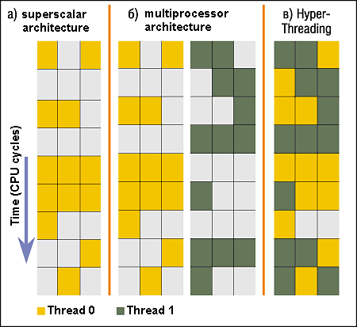
Modern Technique: SMT/Hyperthreading
Hardware technique
Exploit natural properties of superscalar processors to provide illusion of multiple processors
Higher utilization of processor resources
Can schedule each thread as if were separate CPU
However, not linear speedup!
If have multiprocessor, should schedule each processor first
Original technique called “Simultaneous Multithreading”
See http://www.cs.washington.edu/research/smt/
Alpha, SPARC, Pentium 4 (“Hyperthreading”), Power 5

Slide 12
How to protect threads from one another?
Need three important things:
Protection of memory
Every task does not have access to all memory
Protection of I/O devices
Every task does not have access to every device
Protection of Access to Processor: Preemptive switching from task to task
Use of timer
Must not be possible to disable timer from usercode

Slide 13
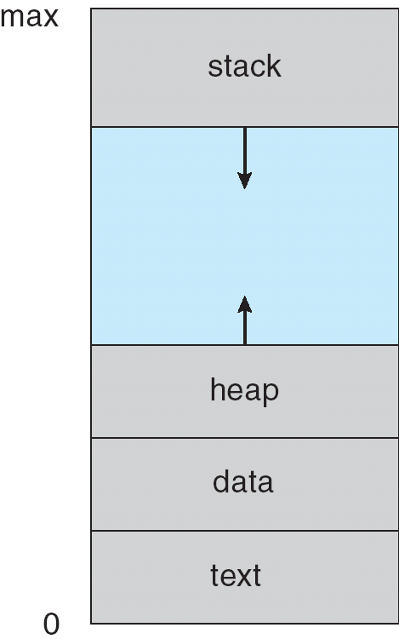
Program’s Address Space
Address space ⇒ the set of accessible addresses + state associated with them:
For a 32-bit processor there are 2³² = 4 billion addresses
What happens when you read or write to an address?
Perhaps Nothing
Perhaps acts like regular memory
Perhaps ignores writes
Perhaps causes I/O operation
(Memory-mapped I/O)
Perhaps causes exception (fault)
Program Address Space

Slide 14
A process’s virtual-memory layout
User space
Kernel space
process descriptor
and
kernel-mode stack
Privilege-level 0
User-mode stack-area
Privilege-level 3
Shared runtime-libraries
Task’s code and data

Slide 15
Providing Illusion of Separate Address Space Switch
Code
Data
Heap
Stack
Data 2
Code
Data
Heap
Stack
Stack 1
Heap 1
Code 1
Stack 2
Prog 1
Virtual
Address
Space 1
Data 1
Prog 2
Virtual
Address
Space 2
Heap 2
Code 2
OS code
Translation Map 1
OS data
Translation Map 2
OS heap &
Stacks
Physical Address Space

Slide 16
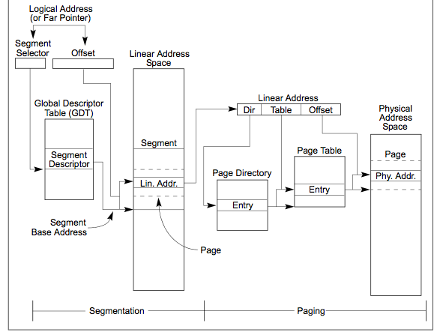
X86 Memory model with segmentation

Slide 17
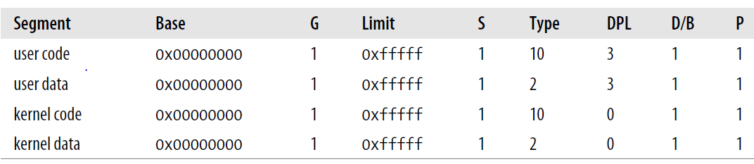
Values of the Segment Descriptor fields for the four main Linux segments
User code and User data
DPL = 3
Kernel code and Kernel data
DPL = 0

Slide 18
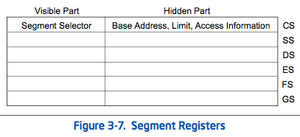
The Six x86 Segment Registers
CS - Code Segment
SS - Stack Segment
“Stack segments are data segments which must be read/write segments. Loading the SS register with a segment selector for a nonwritable data segment generates a general-protection exception (#GP)”
DS - Data Segment
ES/FS/GS - Extra (usually data) segment registers
FS and GS used for thread-local storage/by glibc
The “hidden part” is like a cache so that segment descriptor info doesn’t have to be looked up each time

Slide 19
UNIX Process
Process: Operating system abstraction to represent what is needed to run a single program
Originally: a single, sequential stream of execution in its own address space
Modern Process: multiple threads in same address space!
Two parts:
Sequential Program Execution Streams
Code executed as one or more sequential stream of execution (threads)
Each thread includes its own state of CPU registers
Threads either multiplexed in software (OS) or hardware (simultaneous multithrading/hyperthreading)
Protected Resources:
Main Memory State (contents of Address Space)
I/O state (i.e. file descriptors)
This is a virtual machine abstraction
Some might say that the only point of an OS is to support a clean Process abstraction

Slide 20
Modern “Lightweight” Process with Threads
Thread: a sequential execution stream within process (Sometimes called a “Lightweight process”)
Process still contains a single Address Space
No protection between threads
Multithreading: a single program made up of a number of different concurrent activities
Sometimes called multitasking, as in Ada…
Why separate the concept of a thread from that of a process?
Discuss the “thread” part of a process (concurrency)
Separate from the “address space” (Protection)
Heavyweight Process ≡ Process with one thread
Linux confuses this model a bit:
Processes and Threads are “the same”
Really means: Threads are managed separately and can share a variety of resources (such as address spaces)
Threads related to one another in fashion similar to Processes with Threads within

Slide 21
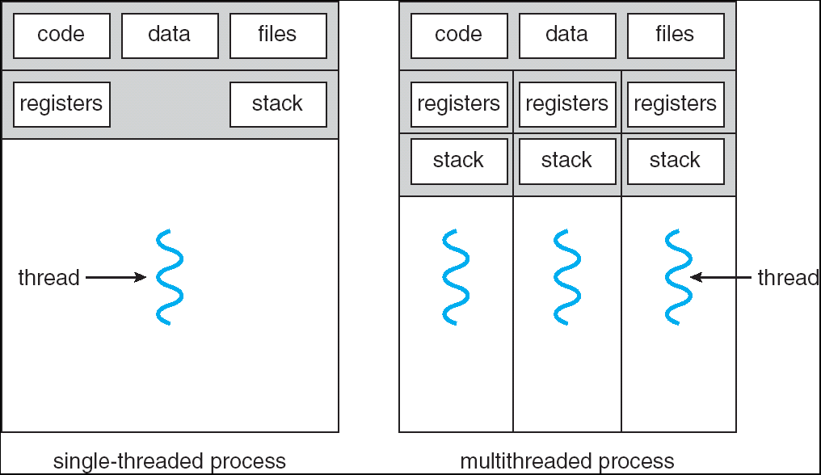
Single and Multithreaded Processes
Threads encapsulate concurrency: “Active” component
Address spaces encapsulate protection: “Passive” part
Keeps buggy program from trashing the system
Why have multiple threads per address space?
Notes:
Sometimes need parallelism for a single job, and processes are very expensive – to start, switch between, and to communicate between

Slide 22
Process comprises
What is in a process?
an address space – usually protected and virtual – mapped into memory
the code for the running program
the data for the running program
an execution stack and stack pointer (SP); also heap
the program counter (PC)
a set of processor registers – general purpose and status
a set of system resources
files, network connections, pipes, …
privileges, (human) user association, …
Personalities (linux)
…

Slide 23
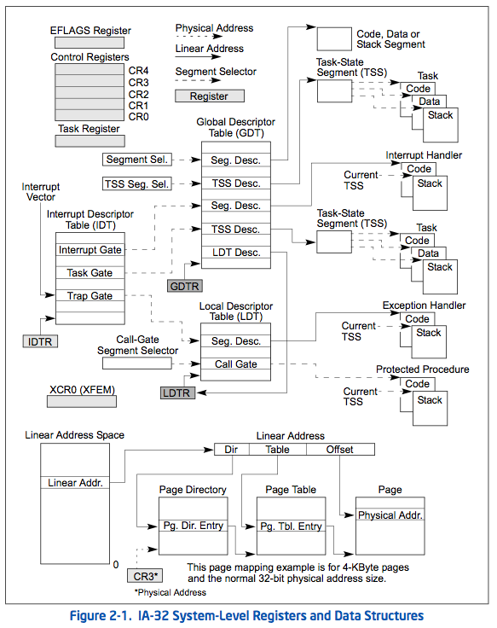
Preview: System-Level Control of x86
Full support for Process Abstraction involves a lot of system-level state
This is state that can only be accessed in kernel mode!
We will be talking about a number of these pieces as we go through the term…
There is a tradeoff between amount of system state and cost of switching from thread to thread!

Slide 24
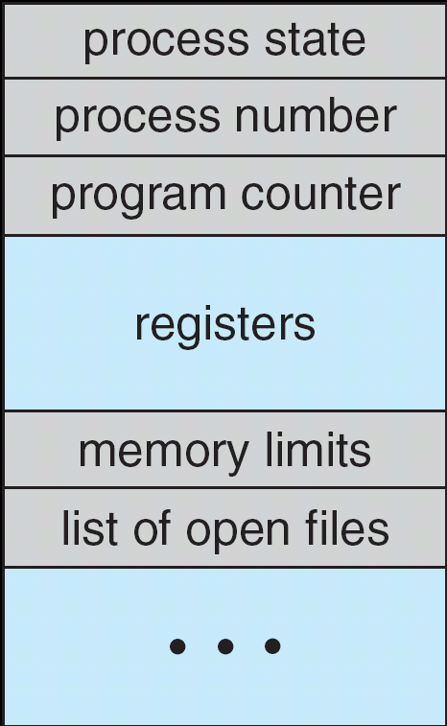
How do we multiplex processes?
The current state of process held in a process control block (PCB):
This is a “snapshot” of the execution and protection environment
Only one PCB active at a time
Give out CPU time to different processes (Scheduling):
Only one process “running” at a time
Give more time to important processes
Give pieces of resources to different processes (Protection):
Controlled access to non-CPU resources
Sample mechanisms:
Memory Mapping: Give each process their own address space
Kernel/User duality: Arbitrary multiplexing of I/O through system calls
Two names:
Process Control Block
Process Descriptor

Slide 25
Stacks and task-descriptors
To manage multitasking, the OS needs to use a data-structure which can keep track of every task’s progress and usage of the computer’s available resources (physical memory, open files, pending signals, etc.)
Such a data-structure is called a ‘process descriptor’ – every active task needs one
Every task needs its own ‘private’ stack
So every task, in addition to having its own code and data, will also have a stack-area that is located in user-space, plus another stack-area that is located in kernel-space
Each task also has a process-descriptor which is accessible only in kernel-space

Slide 26
Processes in the OS – PCB
Typical PCB contains:
execution state
PC, SP & processor registers – stored when process is not in running state
memory management info
Privileges and owner info
scheduling priority
resource info
accounting info

Slide 27
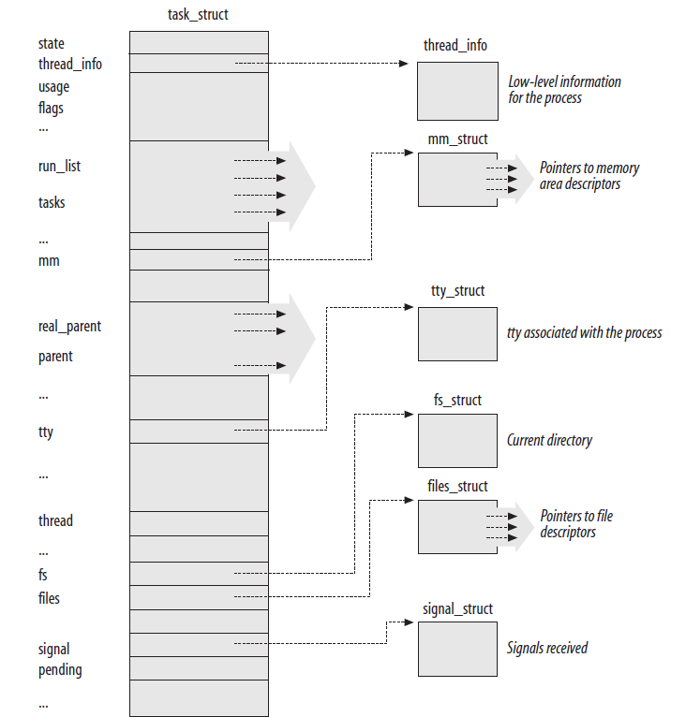
PCB data structure in Linux
task_struct{}
PID
The leader thread’ s PID

Slide 28
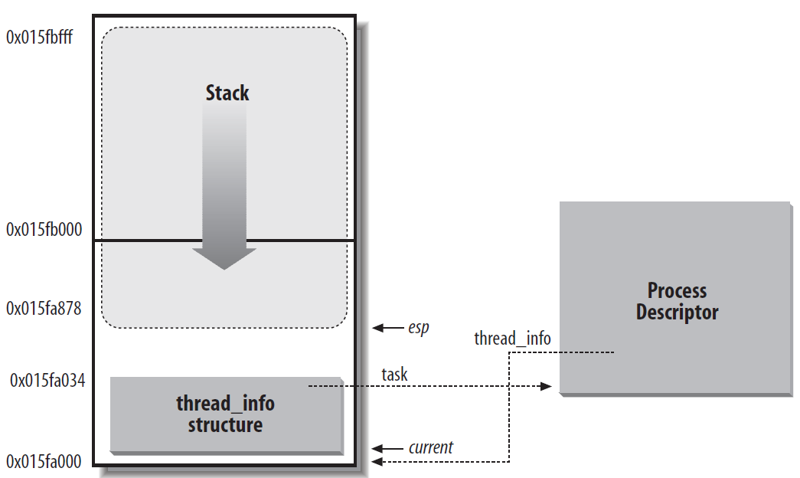
Process descriptors handling
Storing the thread_info structure and the process kernel stack in two page frames
Size of thred_info : 52 bytes

Slide 29
Finding a task’s ‘thread-info’
During a task’s execution in kernel-mode, it’s very quick to find that task’s thread_info object
Just use two assembly-language instructions:
movl $0xFFFFE000, %eax
andl %esp, %eax
Ok, now %eax = the thread-info’s base-address
Masking off 13 bits of the stack yields thread_info
Macro current_thread_info implements this computation
thread_info points to task_struct
current macro yields the task_struct
current is not a static variable, useful for SMP

Slide 30
Finding task-related kernel-data
Use a macro ‘task_thread_info( task )’ to get a pointer to the ‘thread_info’ structure:
struct thread_info *info = task_thread_info( task );
Then one more step gets you back to the address of the task’s process-descriptor:
struct task_struct *task = info->task;

Slide 31
Processes – State Queues
The OS maintains a collection of process state queues
typically one queue for each state – e.g., ready, waiting, …
each PCB is put onto a queue according to its current state
as a process changes state, its PCB is unlinked from one queue, and linked to another
Process state and the queues change in response to events – interrupts, traps

Slide 32
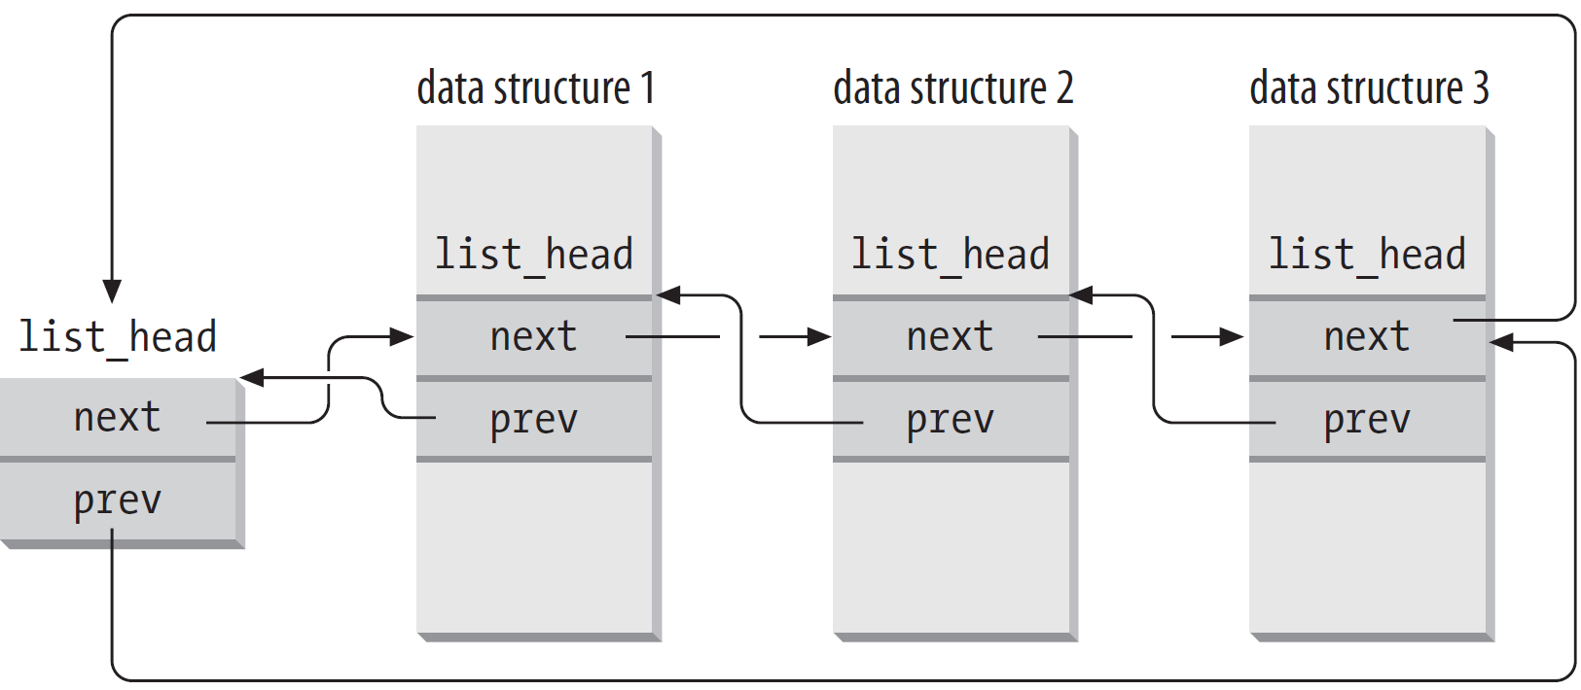
Doubly linked lists and PCB lists
pointers in a list_head field store the addresses of other list_head fields rather than the addresses of the whole data structures in which the list_head structure is included.

Slide 33
Doubly linked list Operations
The list_head is a generic list structure with a set of services:
list_head – declare and initialize list head
list_add – add a list_head after item
list_add_tail – add a list_head before item
list_del – remove list_head from list
list_del_init – remove and initialize list_head
list_empty – is a list empty?
list_for_each, list_for_each_entry, list_entry
next
prev

Slide 34
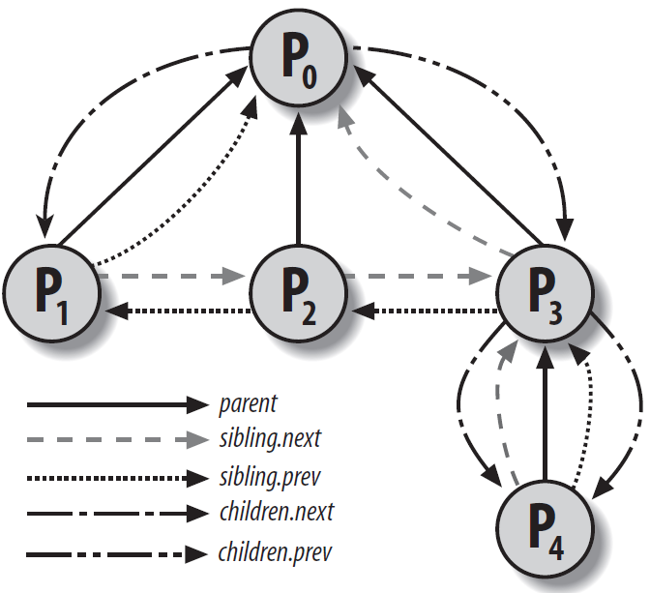
Relationships Among Processes
real_parent
Parent
Children
sibling

Slide 35
Old task_struct lists in Linux
init_task list
run_queue
Those tasks that are ready-to-run comprise a sub-list of all the tasks,
and they are arranged on a queue known as the ‘run-queue’
Those tasks that are blocked while awaiting a specific event to occur
are put on alternative sub-lists, called ‘wait queues’, associated with
the particular event(s) that will allow a blocked task to be unblocked

Slide 36
The pidhash and task lookup
PID: 16-bit process ID
task_structs are found by searching for pid structures, which point to the task_structs. The pid structures are kept in several hash tables, hashed by different IDs:
process ID
thread group ID // pid of first thread in process
process group ID // job control
session ID // login sessions
(see include/linux/pid.h)
Allocated process IDs are recorded in a bitmap representing around four million possible IDs.
PIDs dynamically allocated, avoid immediate reuse

Slide 37
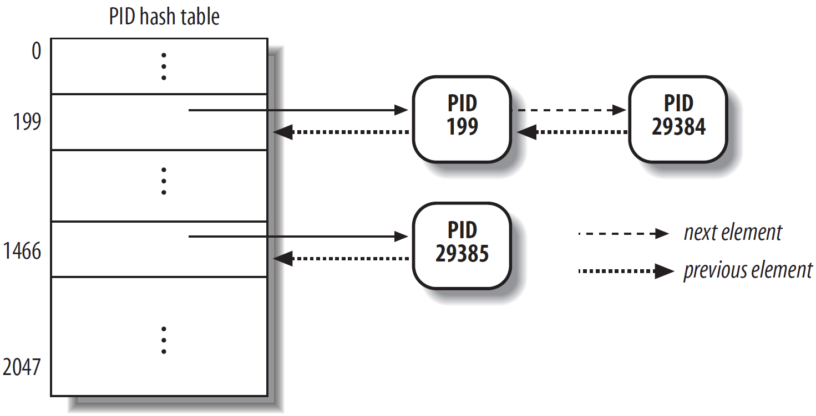
The pidhash table and chained lists
Scanning the process list sequentially and checking the pid fields of the process descriptors is feasible but rather inefficient
To speed up the search, four hash tables named PIDTYPE_PID, PIDTYPE_TGID, PIDTYPE_PGID, PIDTYPE_SID are introduced.

Slide 38
The pidhash table and chained lists
#define pid_hashfn(x) hash_long((unsigned long) x, pidhash_shift)
unsigned long hash_long(unsigned long val, unsigned int bits)
{
unsigned long hash = val * 0x9e370001UL;
return hash >> (32 - bits);
}
When bits = 11, pid_hashfn yields values ranging between 0 and 211 − 1 = 2047
Questions :
How does the kernel retrieve all processes belonging to a given thread group, that is, all processes whose tgid field is equal to a given number?

Slide 39
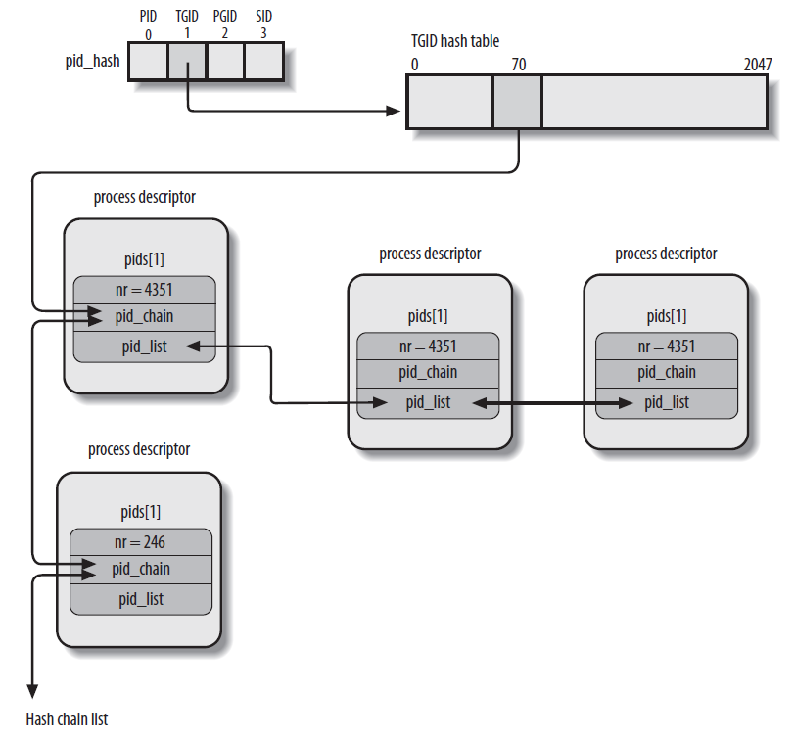
Using pid[ ]struct in PCB

Slide 40
‘run’ queues and ‘wait’ queues
In order for Linux to efficiently manage the scheduling of its various ‘tasks’, separate queues are maintained for ‘running’ tasks and for tasks that temporarily are ‘blocked’ while waiting for a particular event to occur (such as the arrival of new data from the keyboard, or the exhaustion of prior data sent to the printer)

Slide 41
How Processes Are Organized---Wait queues
Wait queues:
a wait queue represents a set of sleeping processes, which are woken up by the kernel when some condition becomes true.
Usage:
interrupt handling
process synchronization
Timing
Queue head
struct __wait_queue_head {
spinlock_t lock;
struct list_head task_list;
};
typedef struct __wait_queue_head wait_queue_head_t;
Queue Elements
struct __wait_queue {
unsigned int flags; // “thundering herd”
struct task_struct * task;
wait_queue_func_t func;
struct list_head task_list;
};
typedef struct __wait_queue wait_queue_t;

Slide 42
How Processes Are Organized---Wait queues
wait_queue_t
wait_queue_head_t can have 0 or more wait_queue_t chained onto them
However, usually just one element
Each wait_queue_t contains a list_head of tasks
All processes waiting for specific "event“
Used for timing, synch, device i/o, etc.
wait_queue_head_t
waitqueue
waitqueue
waitqueue
waitqueue

Slide 43
How Processes Are Organized---How Do I Block?
By calling one of the sleep_on functions:
sleep_on, interruptible_sleep_on, sleep_on_timeout, etc.
These functions create a wait_queue and place the calling task on it
Modify the value of its ‘state’ variable:
TASK_UNINTERRUPTIBLE
TASK_INTERRUPTIBLE
Then call schedule or schedule_timeout
The next task to run calls deactivate_task to move us out of the run queue
Only tasks with ‘state == TASK_RUNNING’ are granted time on the CPU by the scheduler

Slide 44
How Processes Are Organized--- How Do I Wake Up?
By someone calling one of the wake functions:
wake_up, wake_up_all, wake_up_interruptible, etc.
These functions call the curr->func function to wake up the task
Defaults to default_wake_function which is try_to_wake_up
try_to_wake_up calls activate_task to move us out of the run queue
The ‘state’ variable is set to TASK_RUNNING
Sooner or later the scheduler will run us again
We then return from schedule or schedule_timeout

Slide 45
How Processes Are Organized---Handling wait queues
A process wishing to wait for a specific condition
void sleep_on(wait_queue_head_t *wq)
{
wait_queue_t wait;
init_waitqueue_entry(&wait, current);
current->state = TASK_UNINTERRUPTIBLE;
add_wait_queue(wq,&wait); /* wq points to the wait queue head */
schedule(); // similar to contitional var in APUE?
remove_wait_queue(wq, &wait);
}
The kernel awakens processes in the wait queues
void wake_up(wait_queue_head_t *q)
{
struct list_head *tmp;
wait_queue_t *curr;
list_for_each(tmp, &q->task_list) {
curr = list_entry(tmp, wait_queue_t, task_list);
if (curr->func(curr, TASK_INTERRUPTIBLE|TASK_UNINTERRUPTIBLE, 0, NULL) && curr->flags)
break;
}
}

Slide 46
What are all these options?
INTERUPTIBLE vs. NON-INTERUPTIBLE:
Can the task be woken up by a signal?
TIMEOUT vs no timeout:
Wake up the task after some timeout interval
EXCLUSIVE vs. NON-EXCLUSIVE:
Should only one task be woken up?
Only one EXCLUSIVE task is woken up
Kept at end of the list
All NON-EXCLUSIVE tasks are woken up
Kept at head of the list
Functions with _nr option wake up number of tasks

Slide 47
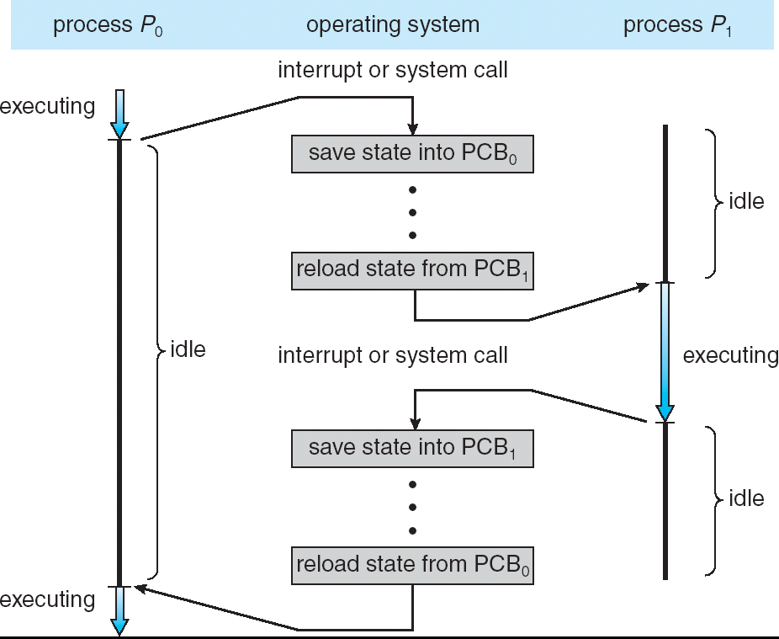
CPU Switch From Process to Process
This is also called a “context switch”
Code executed in kernel above is overhead
Overhead sets minimum practical switching time
Less overhead with SMT/hyperthreading, but… contention for resources instead

Slide 48
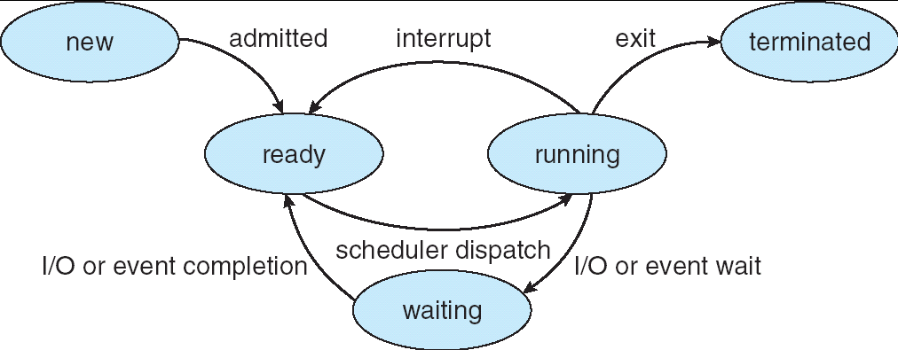
Diagram of Process State
As a process executes, it changes state
new: The process is being created
ready: The process is waiting to run
running: Instructions are being executed
waiting: Process waiting for some event to occur Can be Interruptible or Non-Interruptible
terminated: The process has finished execution Stays as Zombie until relays result to parent

Slide 49
All of Task States
From kernel-header: <linux/sched.h>
#define TASK_RUNNING 0
#define TASK_INTERRUPTIBLE 1
#define TASK_UNINTERRUPTIBLE 2
#define TASK_STOPPED 4
#define TASK_TRACED 8
#define EXIT_ZOMBIE 16
#define EXIT_DEAD 32
#define TASK_NONINTERACTIVE 64
#define TASK_DEAD 128

Slide 50
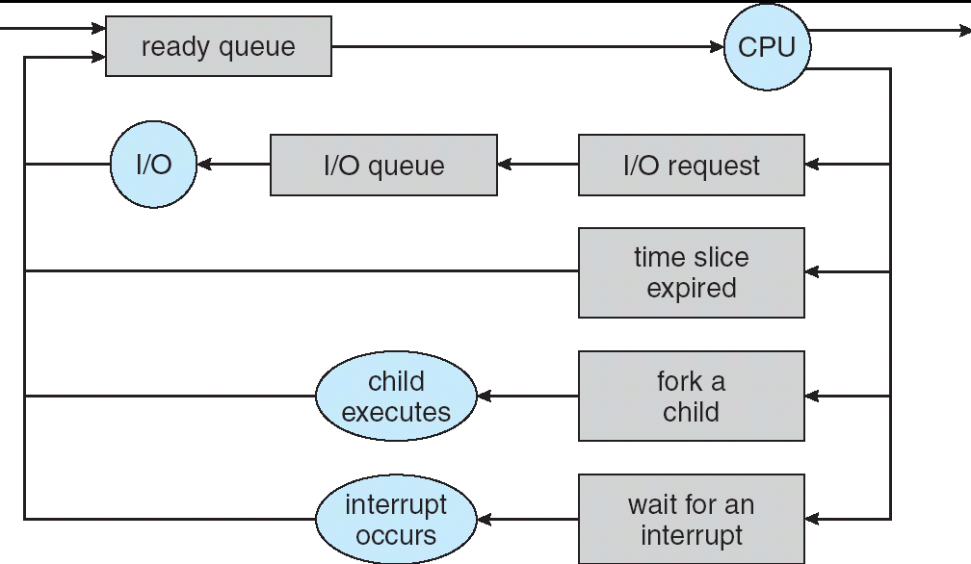
Process Scheduling
PCBs move from queue to queue as they change state
Decisions about which order to remove from queues are Scheduling decisions
Many algorithms possible (few weeks from now)

Slide 51
Processes – Privileges
Users are given privileges by the system administrator
Privileges determine what rights a user has for an object.
Unix/Linux – Read|Write|eXecute by user, group and “other” (i.e., “world”)
Processes “inherit” privileges from user

Slide 52
Linux Kernel Implementation
Kernel may execute in either Process context or Interrupt context
In Process context, kernel has access to
Virtual memory, files, other process resources
May sleep, take page faults, etc., on behalf of process
In Interrupt context, no assumption about what process was executing (if any)
No access to virtual memory, files, resources
May not sleep, take page faults, etc.

Slide 53
Process Creation – Unix & Linux
Create a new (child) process – fork();
Allocates new PCB
Clones the calling process (almost exactly)
Copy of parent process address space
Copies resources in kernel (e.g. files)
Places new PCB on Ready queue
Return from fork() call
0 for child
child PID for parent
Copy-on-Write optimization
Copy parent address space ⇒ copy page tables
All pages marked as read only
Actual pages copied only on write

Slide 54
Context Switch
Context switching is the process of saving the state of the currently running task and loading the state of the next task to run.
This involves saving the task's CPU state (registers), changing the current task value, and loading the CPU state of the new task into the registers.
schedule determines the next task to run, calls context_switch, which calls switch_mm to change the process address space, then calls switch_to to context switch to the new task.

Slide 55
Context Switch: switch_mm
switch_mm is architecture specific. It generally loads any hardware state required to make the process' user address space addressable in user mode. If the address space is unchanged (task switching between threads in one process), very little is done.

Slide 56
Task State Segment to store hardware contexts.
When an 80×86 CPU switches from User Mode to Kernel Mode, it fetches the address of the Kernel Mode stack from the TSS (see the sections “Hardware Handling of Interrupts and Exceptions”
When a User Mode process attempts to access an I/O port by means of an in or
out instruction,

Slide 57
Task State Segment to store hardware contexts.
When an 80×86 CPU switches from User Mode to Kernel Mode, it fetches the address of the Kernel Mode stack from the TSS (see the sections “Hardware Handling of Interrupts and Exceptions”
When a User Mode process attempts to access an I/O port by means of an in or
out instruction
Each TSS has its own 8-byte Task State Segment Descriptor (TSSD).
The TSSDs created by Linux are stored in the Global Descriptor Table (GDT)

Slide 58
Task State Segment –thread field
each process descriptor includes a field called thread of type thread_struct, in which the kernel saves the hardware context whenever the process is being switched out.
thread_struct includes fields for most of the CPU registers such as eax, ebx

Slide 59
Context Switch: switch_to
switch_to is architecture specific.
Generally, it saves the old task’s hardware state of the CPU (registers) to one of three places:
The task's kernel stack
the thread_struct
task_struct->thread
It then copies the new task's hardware state from the appropriate places
Stack is in next->thread.esp

Slide 60
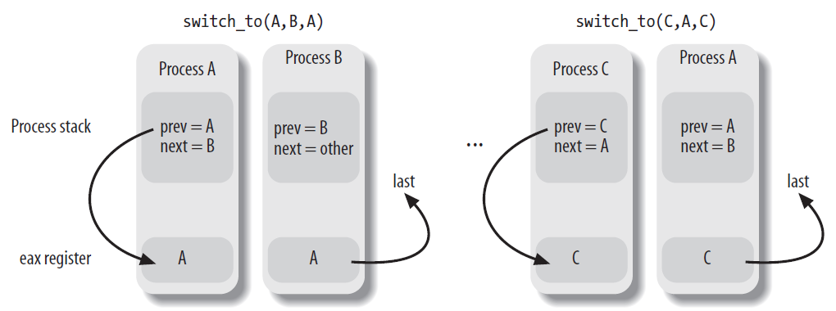
Context Switch: switch_to
3 parameters in switch_to(Prev,next,last)
Prev, next, last
Pointing to PCB

Slide 61
Creating New Processes
Using three different mechanisms:
The Copy On Write technique allows both the parent and the child to read the same physical pages
Lightweight processes allow both the parent and the child to share many perprocess kernel data structures
The vfork( ) system call creates a process that shares the memory address space

Slide 62
Creating New Processes
The fork system call is used to create a new process.
Identical to parent except …
execution state
process ID
parent process ID.
other data is either copied (like process state) or made copy on write (like process address space).
Copy on write allows data to be shared as long as it is not modified, but each task gets its own copy when one task tries to modify the data.

Slide 63
Creating New Processes
The fork system call uses do_fork to create a new task. The flags passed to do_fork indicate which task attributes to copy and which to create anew.
do_fork calls copy_process to create a new task_struct and initialize it appropriately.

Slide 64
do_fork
do_fork creates a new task and allows the new task to share resources with the calling task.
The following options specify what should be shared with the calling task:
CLONE_VM - share address space
CLONE_FS - share root and current working directories
CLONE_FILES - share file descriptors
CLONE_SIGHAND - share signal handlers
CLONE_PARENT – share parent process ID
CLONE_THREAD – create thread for process

Slide 65
Creating New Threads
The clone system call also uses do_fork to create a new task.
The clone system call takes flags which are passed to do_fork to indicate which task attributes to copy and which to create anew.
This system call gives applications the ability to create new processes, new threads, or new tasks that have the attributes of both processes and threads.
clone is used by threads libraries to create new kernel threads.

Slide 66
Creating tasks using clone func
Fork a child process
Clone(CLONE_VM|CLONE_FS|CLONE_FILES|CLONE_SIGHAND, 0);
vfork a child process
Clone(CLONE_VFORK|CLONE_VM|SIGCHILD, 0);

Slide 67
Destroying a Task
Tasks stop executing when they call the exit system call, are killed by the kernel (due to an exception), or are killed by a fatal signal which was sent.
exit calls do_exit which decrements usage counts on the sub-structures of the task_struct. Any substructure with a zero usage count has its memory freed.
Lastly, the task is changed to the EXIT_ZOMBIE state.
task_structs are actually destroyed by release_task, which is called when the process' parent calls the wait system call.
extremely difficult for a task to delete its own task structure and kernel stack.
also provides an easy mechanism for parents to determine their children's exit status.
release_task removes the task from the task list and frees its memory.
The init process cleans up children.

Slide 68
Kernel Threads
Linux has a small number of kernel threads that run continuously in the kernel (daemons)
No user address space
Only execute code and access data in kernel address space( > PAGE_OFFSET )
How to create: kernel_thread
Scheduled in the same way as other threads/tasks
Process 0: idle process/swapper process
Create Process1 ; cpu_idle();
Process 1: init process
Spawns several kernel threads before transitioning to user mode as /sbin/init
kflushd (bdflush) – Flush dirty buffers to disk under "memory pressure"
kupdate – Periodically flushes old buffers to disk
kswapd – Swapping daemon

Slide 69
Task Zero
The task with process ID zero is called the swapper or the idle task
Its task structure is in init_thread_union, which also includes its kernel stack.
The kernel builds this task piece by piece to use to boot the system. (All other tasks are copied from an existing task by do_fork.)
All other tasks are maintained in a linked list off of this task.
This task becomes the idle task that runs when no other task is runnable.
This task forks the init task (task 1) and is the ancestor of all other tasks.

Slide 70
Task Zero
On SMP systems, this task uses clone to create duplicate tasks which run as the idle task on each of the other processors.
All of these tasks have process ID zero.
Each of these tasks is used only by its associated processor.

Slide 71
Threads
Threads in a process are represented by creating a task_struct for each thread in the process and keeping most of the data the same for each task_struct.
ultimately done by using do_fork
simplifies some algorithms because there is only one structure for both processes and threads.
can improve performance for single threaded processes.
Process data is generally in task sub-structures which can be shared by all tasks in the process.

Slide 72
Thread Structures
The thread state is represented by the thread_info structure.
The thread_info structure has a reference to the task_struct for the thread as well as the execution domain for the program the thread is executing within.
The thread_info structure and the thread's kernel stack are located together within a thread_union structure. size varies by architecture
thread’s stack thus also varies by architecture
just less than 8K in size on 32-bit architectures
just less than 16K in size on 64-bit architectures.

Slide 73
Backup Slides

Slide 74
Wait Queues
Blocking operations are generally implemented using wait queues.
Multiple tasks can be listed on the same wait queue.
The data structure for the head of a wait queue is wait_queue_head_t.
The wait_queue_head_t points to a list of wait_queue_t structures.
The wait_queue_t structures reference the enqueued task_struct and a function to call to wake up the task.

Slide 75
Wait Queues
Several functions work with wait queues:
init_waitqueue_head – initialize wait queue before using it for the first time
add_wait_queue – add a task to wait queue
remove_wait_queue – remove a task from a wait queue
add_wait_queue_exclusive – add a task to wait queue and designate it exclusive

Slide 76
Wait Queues
Several higher level functions add the current task to a wait queue:
sleep_on – put the current task on the wait queue, return when event occurs
sleep_on_timeout – put the current task on the wait queue, but also return if timeout occurs
interruptible_sleep_on – put the current task on the wait queue, but also return if a signal is received
interruptible_sleep_on_timeout – put the current task on the wait queue, but return if signal, event, or timeout occurs

Slide 77
Wait Queues
Several higher level functions add the current task to a wait queue:
prepare_to_wait – put the current task on the wait queue but check for race condition (replacement for sleep_on)
prepare_to_wait_exclusive – put the current task on the wait queue but check for race condition (replacement for sleep_on, with exclusive wakeup)

Slide 78
Wait Queues
Several higher level functions remove one or more tasks from a wait queue:
wake_up – wake up one task
wake_up_nr – wake up a certain number of tasks
wake_up_all – wake up all tasks
wake_up_all_nr – wake up a certain number of tasks
wake_up_sync – wake up one task, without forcing an idle CPU to run it
These wake up only interruptible tasks:
wake_up_interruptible
wake_up_interruptible_nr
wake_up_interruptible_all
wake_up_interruptible_sync

Slide 79
Wait Queues
When waking up one task, the first appropriate task on the list is chosen. This will be the task that slept last.
Access to a wait queue is serialized using a spin lock in the wait_queue_head_t structure.
The wait_queue_t structures are linked together using list_head structures.

Slide 80
Process Limits
Optional resource limits (accounting)
getrlimit(), setrlimit() (user control)
Root can establish rlim_min, rlim_max
Usually RLIMIT_INFINITY
Resources (RLIMIT_whatever)
CPU, FSIZE (file size), DATA (heap), STACK,
CORE, RSS (frames), NPROC (# processes),
NOFILE (# open files), MEMLOCK, AS

Slide 81
Descriptor Storage/Allocation
Descriptors stored in kernel data segment
Each process gets a 2 page (8K) "kernel stack" used while in the kernel (security)
task_struct stored here; rest for stack
Easy to derive descriptor from esp (stack ptr)
Implemented as union task_union { }
Small (16) cache of free task_unions
free_task_struct(), alloc_task_struct()

Slide 82
Task Serialization
Allocation of substructures of the task_struct is serialized with the alloc_lock in the task_struct. This lock is also used when first accessing any of the substructures of the task_struct.
Manipulation of the lists that a task_struct is on is serialized by disabling local interrupts and holding the global read/write lock tasklist_lock.

